Slide 1
Systems Analysis and Design 11th Edition
Toolkit D – The Systems Analyst’s Toolkit Internet Resource Tools

Slide 2
Chapter Objectives
Describe the characteristics of the Internet and the web
Plan an Internet search strategy, review your information requirements, use the proper search tools and techniques, evaluate the results, and consider copyright and data integrity issues
Use search engines, subject directories, and the invisible web to locate the information you require

Slide 3
Chapter Objectives (Cont.)
Demonstrate advanced search techniques, including Boolean logic and Venn diagrams
Describe Internet communication channels, including social networking, forums, newsletters, blogs, podcasts, RSS feeds, webinars, mailing lists, chat rooms, instant messaging, and text messaging
Provide examples of IT community resources of value to a systems analyst
Explain the benefits and disadvantages of online learning opportunities

Slide 4
Introduction
The Internet
Provides assistance with technical problems
Helps individuals advance their careers
Provides access to training, education, and communication with other IT professionals
Provides access to the World Wide Web
The web contains billions of webpages, which are text and multimedia documents
Web browser: Software program that displays webpages that are delivered by a web server

Slide 5
Planning an Internet Research Strategy
A four-step plan can be used to navigate efficiently and confidently toward one’s objectives
Review information requirements
Use the proper search tools and techniques
Evaluate the results
Consider copyright and data integrity issues

Slide 6
Planning an Internet Research Strategy (Cont. 1)
Review Your Information Requirements
Understand what is being searched
Thinking about the topic helps in conducting a successful search
Use the Proper Search Tools and Techniques
Decisions need to be made on selecting:
Search engines or subject directories
Commercial sites, IT publications, professional associations, forums, or other areas
Expertise in using Internet tools and resources increases with experience

Slide 7
Planning an Internet Research Strategy (Cont. 2)
Evaluate the Results
Ask questions when accessing content
Is the author identifiable and an expert on the subject?
Does the information come from a commercial source that is offering its own solution?
Is the information specific enough?
How old is the information? Is the topic static or dynamic?
Is the information easy to access and navigate?

Slide 8
Planning an Internet Research Strategy (Cont. 3)
Consider Copyright and Data Integrity Issues
Before copying or downloading search results, ensure that:
The material can legally be used
Content is free of threats

Slide 9
Search Basics
Search engine: Application that uses key words and phrases to locate information on the Internet
Meta-search engine: Applies multiple search engines simultaneously
Searching a subject or topic directory involves using a hierarchy
Start with a general heading and proceed to more specific topics
Invisible, deep, or hidden web
Not detected by search engines but can be accessed using other tools and techniques

Slide 10
Search Engines
Often the best starting point for gathering information
A well-planned search narrows the range of content to a manageable level
Individuals can explore available choices or execute a sub search within the focused results
It is important to understand the intended use and limitations of a search engine before applying it to a task

Slide 11
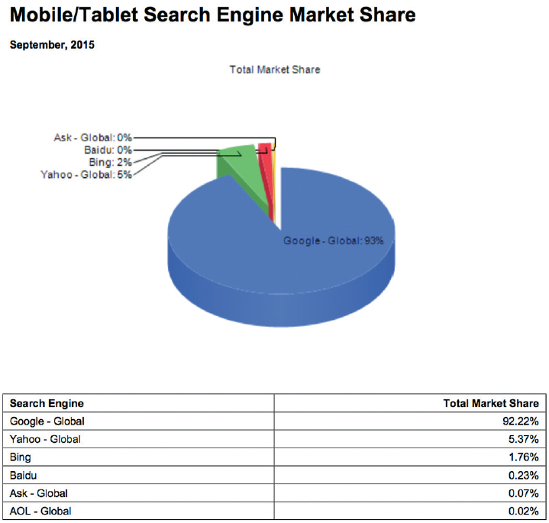
Search Engines (Cont. 1)
Search Engine Concepts
Search engines use a spider or crawler
Spider (crawler): Software program that travels from site to site indexing, the contents of the pages based on keywords
Issue – Sponsored links are ranked better
FIGURE D-1 The chart shows the dominant market share enjoyed by Google on mobile devices.
Source: Netmarketshare

Slide 12
Search Engines (Cont. 2)
Indexed search engines: Organize and rank the results of a search
Examples - Google and Bing
Each engine has its own search algorithms, features, and user interface
Meta-search engines - Collect results from indexed search engines
Review all the results and eliminate duplicates
Example - Dogpile

Slide 13
Search Engines (Cont. 3)
Search Techniques
Refine the topic
Helps avoid an overwhelming number of results
Translate the question into an effective search query
Searches are executed on keywords
Review the search results and evaluate the quality of the results
Use the site’s advanced search techniques if refinement is required
Organize the results of the search
Create favorites or bookmarks

Slide 14
Search Engines (Cont. 4)
Advanced Search Techniques
Include options to:
Search within returned results
Search within specific areas
Boolean logic: Refers to the relationships among search terms based on logical operators such as OR, AND, and NOT
Phrases are more specific than an AND operator
In implied Boolean logic, symbols represent Boolean operators
Many users find it easier to use the advance search feature than to work with Boolean operators

Slide 15
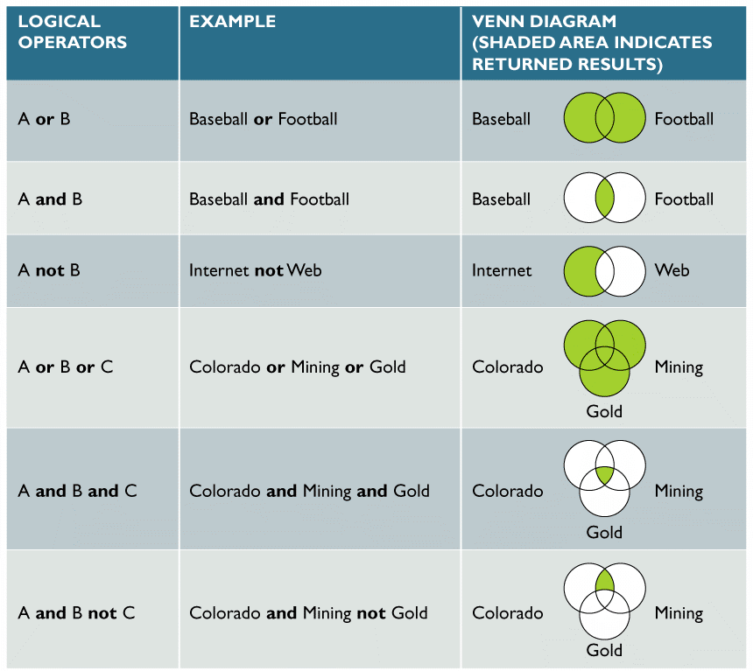
Search Engines (Cont. 5)
FIGURE D-3 Examples of logical operators OR, AND, and NOT. The shaded areas represent the returned results. OR is the most inclusive term, returning results if any of the terms appear. AND requires all keywords to appear. NOT excludes results even if they are found in the same document.

Slide 16
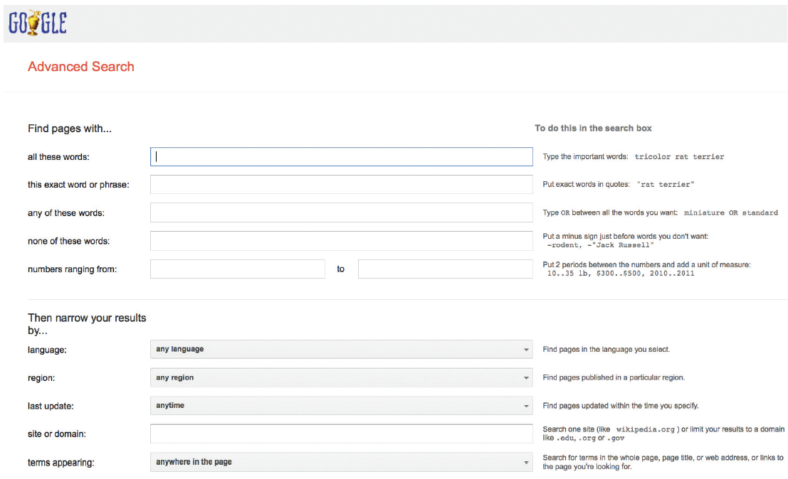
Search Engines (Cont. 6)
FIGURE D-4 Google offers advanced search capabilities with many user-selectable criteria.
Source: Google Inc.

Slide 17
Search Engines (Cont. 7)
Search Checklist
Does the topic have any unique words, phrases, or acronyms?
Do any of the search terms have other spellings or names?
Are certain additional words or phrases likely to appear in any web document?
Is there any unrelated material that the search terms might pick up?
Are any organizations, publications, or institutions likely to have an interest in the topic?
Is the search returning too many results to examine?

Slide 18
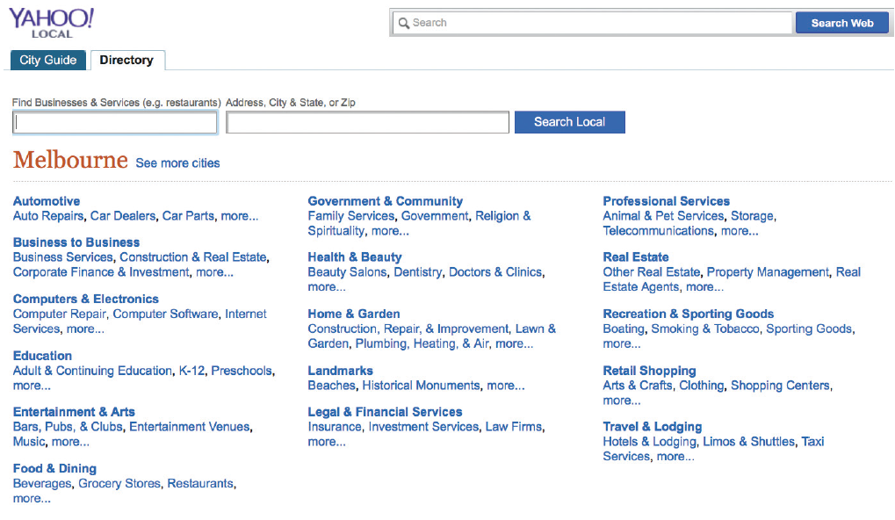
Subject Directories
Provides an overview when one is not sure of the size and scope of the topic
Figure D-5 Yahoo! provides a searchable subject directory of resources available in
your local area. In this case, in and around Melbourne, Florida.
Source: Yahoo Inc.

Slide 19
Subject Directories (Cont.)
Disadvantages
Subjective decisions might affect the quality of search results
May not be updated
Individuals are required to force their way through a series of levels rather than use specific words

Slide 20
The Invisible Web
Information on the Internet that is unindexed
Invisible Web Examples
Specialized topic databases
Hardware and software vendors
Publications, libraries, and government databases
Auction sites, locators, and career opportunities
Navigation Tools for the Invisible Web
Use a search engine to locate a portal, or entrance, to a searchable database by including the word, database, as a required search term
Use a proprietary database

Slide 21
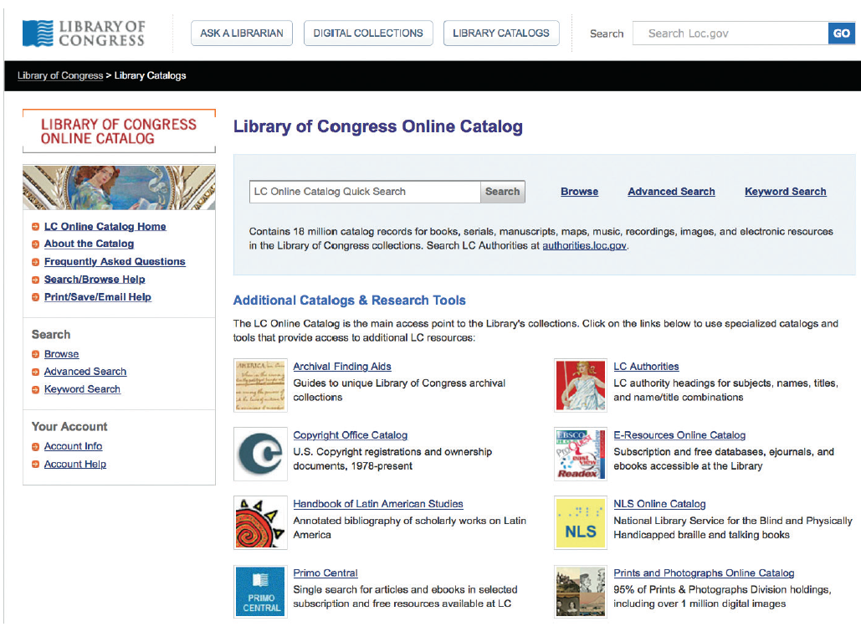
The Invisible Web (Cont. 1)
FIGURE D-6 The Library of Congress online catalog lets you search its vast collection of resources.
Source: Library of Congress

Slide 22
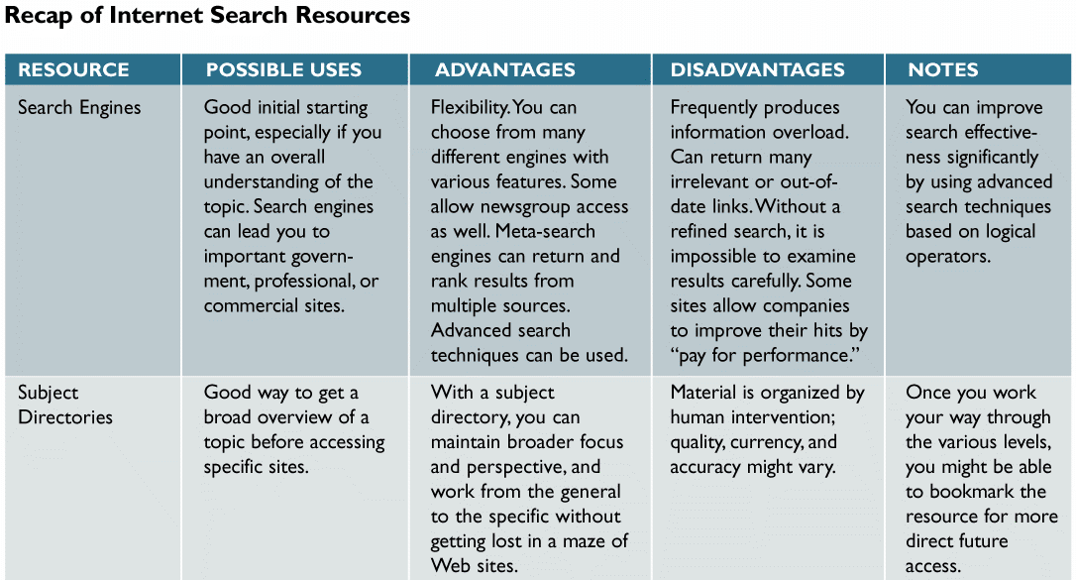
The Invisible Web (Cont. 2)
FIGURE D-7 A recap of the three main Internet search resources: search engines, subject directories, and the invisible Web. Notice that each option has advantages and disadvantages.

Slide 23
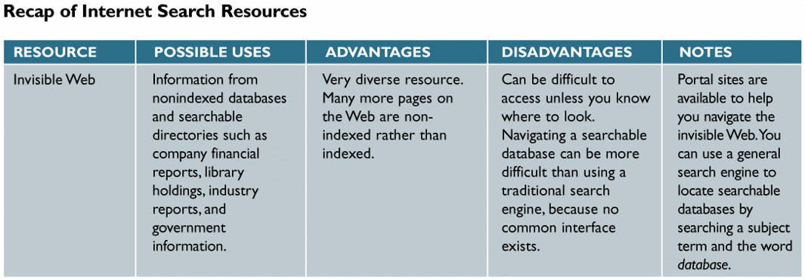
The Invisible Web (Cont. 3)
FIGURE D-7 A recap of the three main Internet search resources: search engines, subject directories, and the invisible Web. Notice that each option has advantages and disadvantages.

Slide 24
Internet Communication Channels
Social Networking
Sites such as Facebook, Twitter, and LinkedIn have gained enormous popularity in recent years
Allows one to connect to an extended family of personal and professional contacts
Forums
Offer online discussions addressing many subjects
Individuals can tap into the knowledge and opinions of others in a large online community

Slide 25
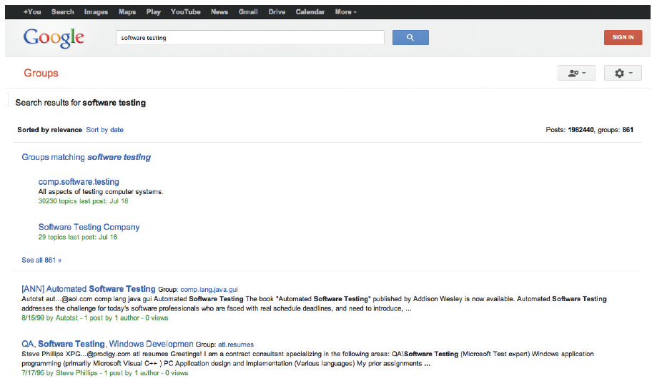
Internet Communication Channels (Cont. 1)
FIGURE D-9 Google Groups allows you to participate in numerous discussion groups on every imaginable topic, and to create new groups.
Source: Google Inc.

Slide 26
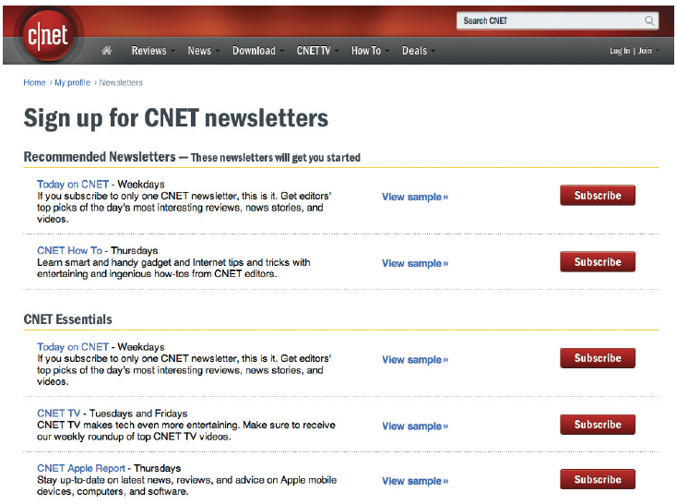
Internet Communication Channels (Cont. 2)
Newsletters, Blogs, Podcasts, and Videos
Many online magazines offer free e-mail newsletters
Blogs: Web-based, logs or journals
Podcast: Audio blog
Online video services
Example - YouTube
FIGURE D-10 CNET offers numerous free newsletters, many of which are delivered in video format.
Source: CBS Interactive Inc.

Slide 27
Internet Communication Channels (Cont. 3)
Really Simple Syndication (RSS) Feeds
Older format for publishing frequently updated content to users who subscribe to an RSS download
Feed reader (aggregator): Software used to read RSS feed
Mailing Lists
Provides a forum for people who want to exchange information about specific topics
List server (listserv): Computer that directs email to people who subscribe to the mailing list

Slide 28
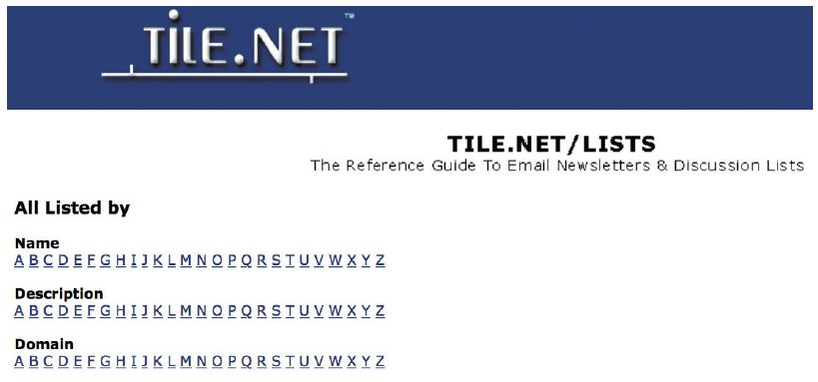
Internet Communication Channels (Cont. 4)
FIGURE D-11 Tile.net is an example of a website that organizes mailing lists by name and subject.
Source: Tile.net

Slide 29
Internet Communication Channels (Cont. 5)
Chat Rooms (Channels)
An online meeting place where users can interact and converse in real time
Used in conjunction with webinars
Instant Messaging (IM) and Text Messaging
Instant messaging allows online users to exchange messages immediately, even while working in another program or application
Texts messages are sent across mobile phones or wireless devices

Slide 30
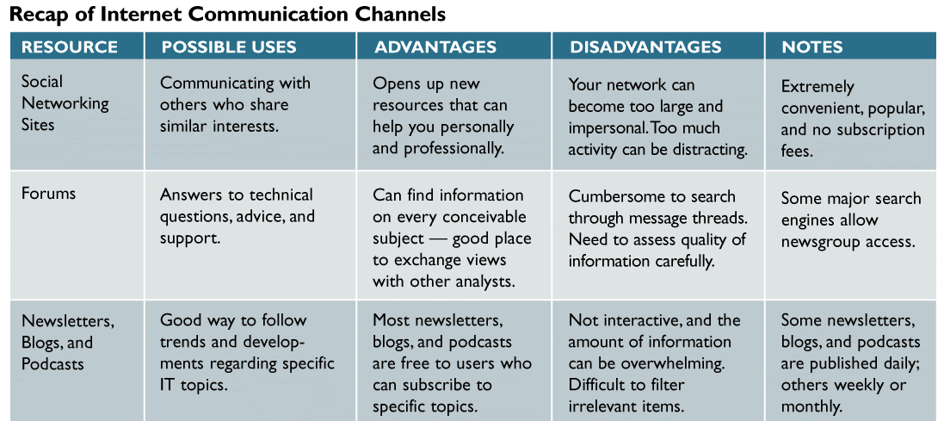
Internet Communication Channels (Cont. 6)
FIGURE D-12 A recap of Internet communication channels that can assist a systems analyst in online research and communication. Notice that each option has advantages and disadvantages.

Slide 31
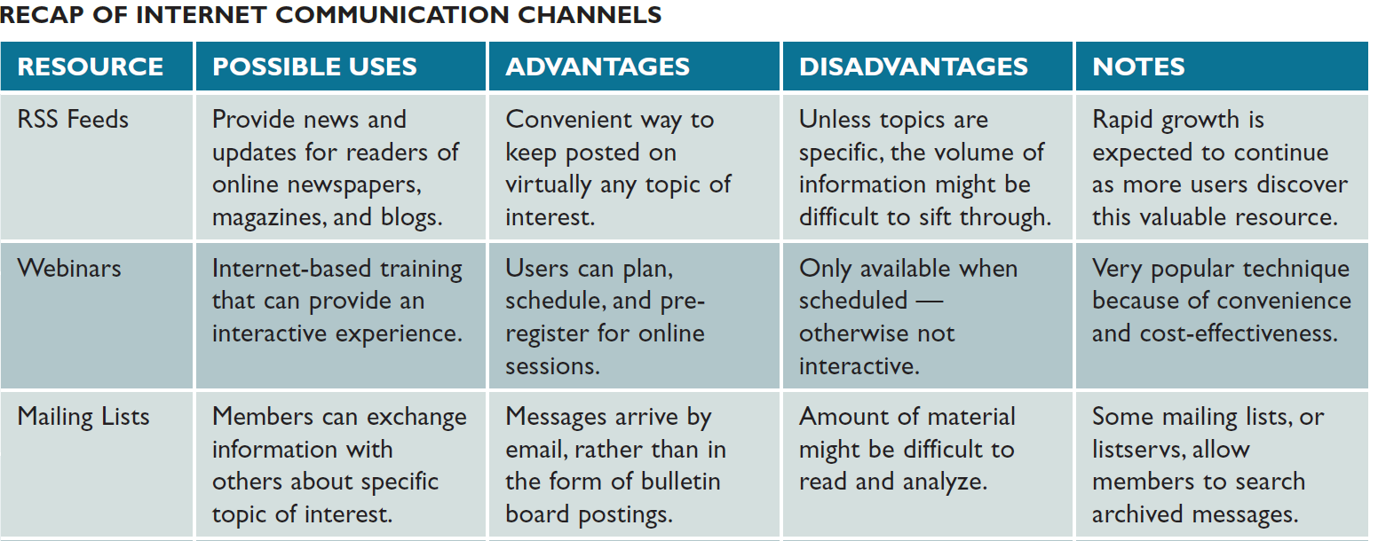
Internet Communication Channels (Cont. 7)
FIGURE D-12 A recap of Internet communication channels that can assist a systems analyst in online research and communication. Notice that each option has advantages and disadvantages.

Slide 32
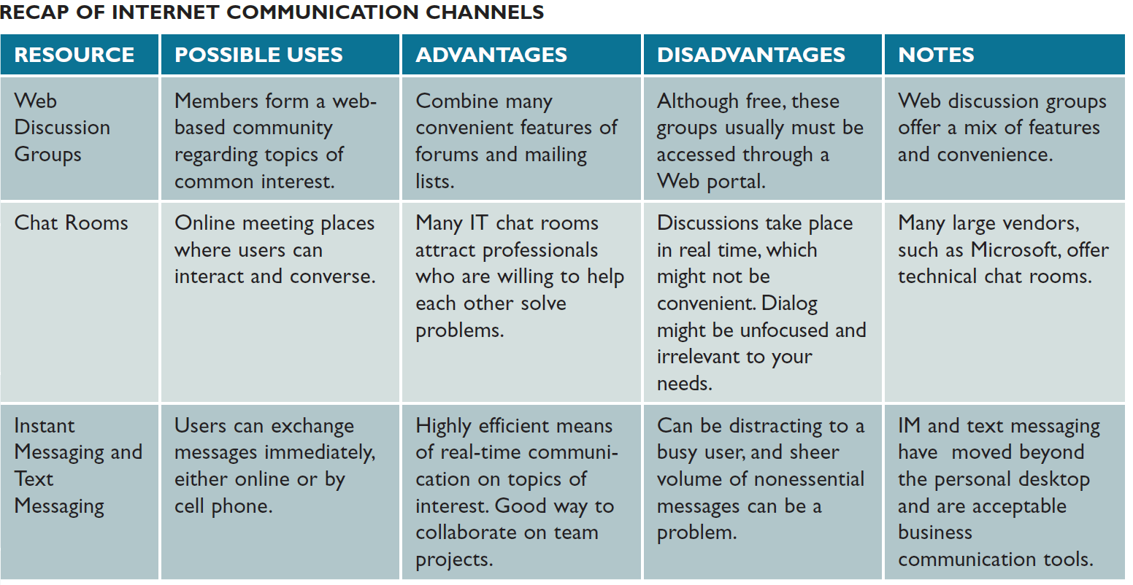
Internet Communication Channels (Cont. 8)
FIGURE D-12 A recap of Internet communication channels that can assist a systems analyst in online research and communication. Notice that each option has advantages and disadvantages.

Slide 33
Information Technology Community Resources
The IT community includes
Publications and online magazines
Searchable databases, web-based discussion groups, and mailing lists
Components of the IT community
Corporate, government, professional, and online learning resources
Corporate Resources
Provide general IT knowledge and background
Help solve specific business challenges

Slide 34
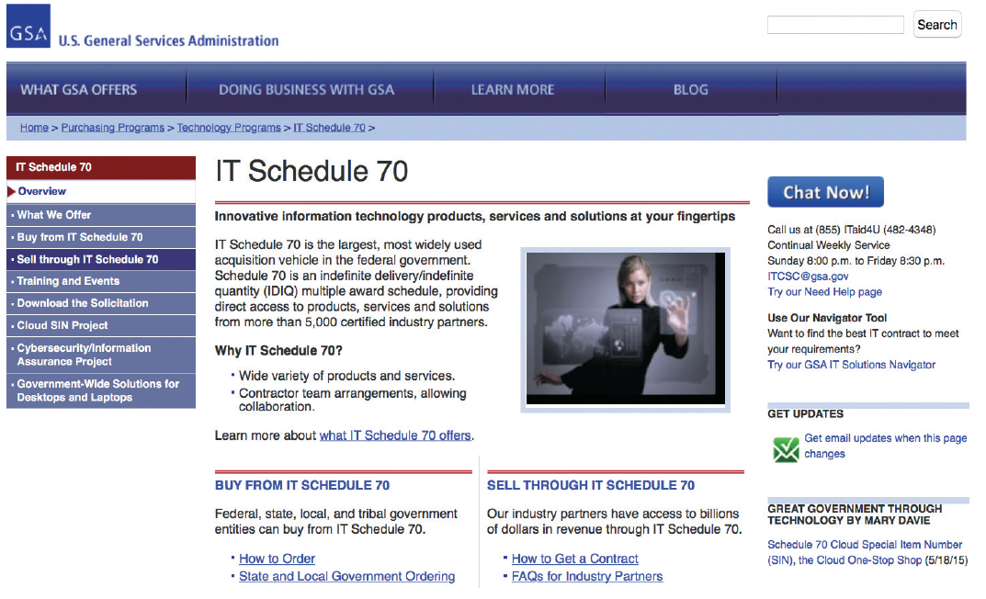
Information Technology Community Resources (Cont. 1)
Government Resources
Excellent federal IT resources exist
FIGURE D-13 The GSA site contains information about federal IT policies, news, and related links. The screen shows a sample from the IT Regulations, Guidelines, and Laws section.
Source: U.S. General Services Administration

Slide 35
Information Technology Community Resources (Cont. 2)
Personal and Professional Resources
Social networks are considered small virtual communities
IT-related associations
Membership is inexpensive or free
Examples - Information Technology Association of America (ITAA) and Association for Computing Machinery (ACM)

Slide 36
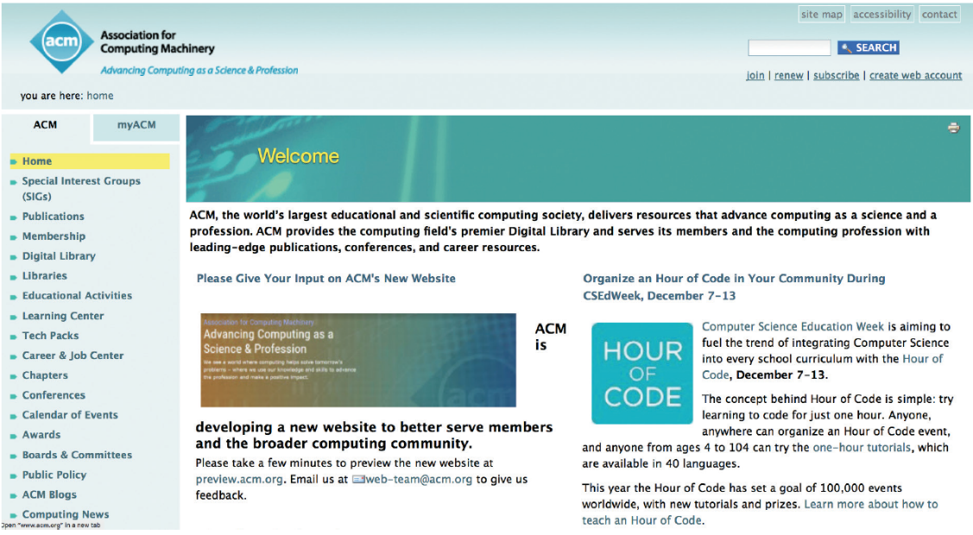
Information Technology Community Resources (Cont. 3)
FIGURE D-14 The ACM website is one of many resources that a systems analyst can use to keep up with current issues, trends, and opportunities.
Source: ACM, Inc.

Slide 37
Information Technology Community Resources (Cont. 4)
Online Learning Resources (e-learning)
Delivery of educational or training content over the public Internet or an intranet
Benefits - Convenient, economical, and customizable
Disadvantages
Lacks face-to-face interaction
Interface in an online learning experience may be a limitation
May not be suitable if the content is complicated or unfamiliar to the learner

Slide 38
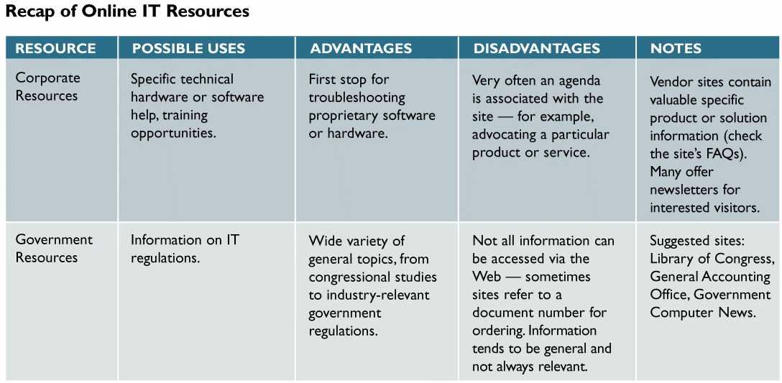
Information Technology Community Resources (Cont. 5)
FIGURE D-15 A recap of online resources that a systems analyst can use to keep up with current issues and trends in IT. Notice that each option has advantages and disadvantages.

Slide 39
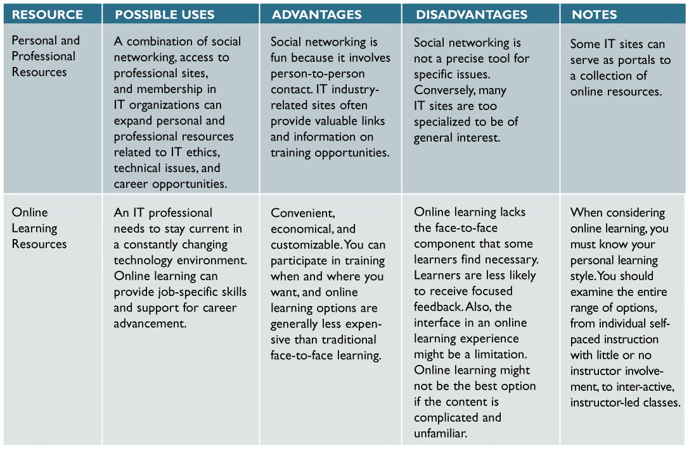
Information Technology Community Resources (Cont. 6)
FIGURE D-15 A recap of online resources that a systems analyst can use to keep up with current issues and trends in IT. Notice that each resource has advantages and disadvantages.

Slide 40
Toolkit Summary
The Internet integrates networks on a worldwide scale
Allows access to the World Wide Web
An Internet research strategy should use the four-step approach
Primary research tools
Search engines, subject directories, and the invisible web
Subject directory allows one to access topics by using a hierarchy

Slide 41
Toolkit Summary (Cont.)
The invisible web describes text, graphics, and data files stored in collections that are unreachable by search engines
Many analysts use social networking as an online tool to expand personal and professional contacts
IT professional can use the IT community to research a topic or seek background information
Online learning helps IT workers to remain current in their chosen areas

